Slide 1
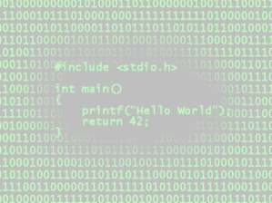
History and Origin of the C Family of Programming Languages

Slide 2
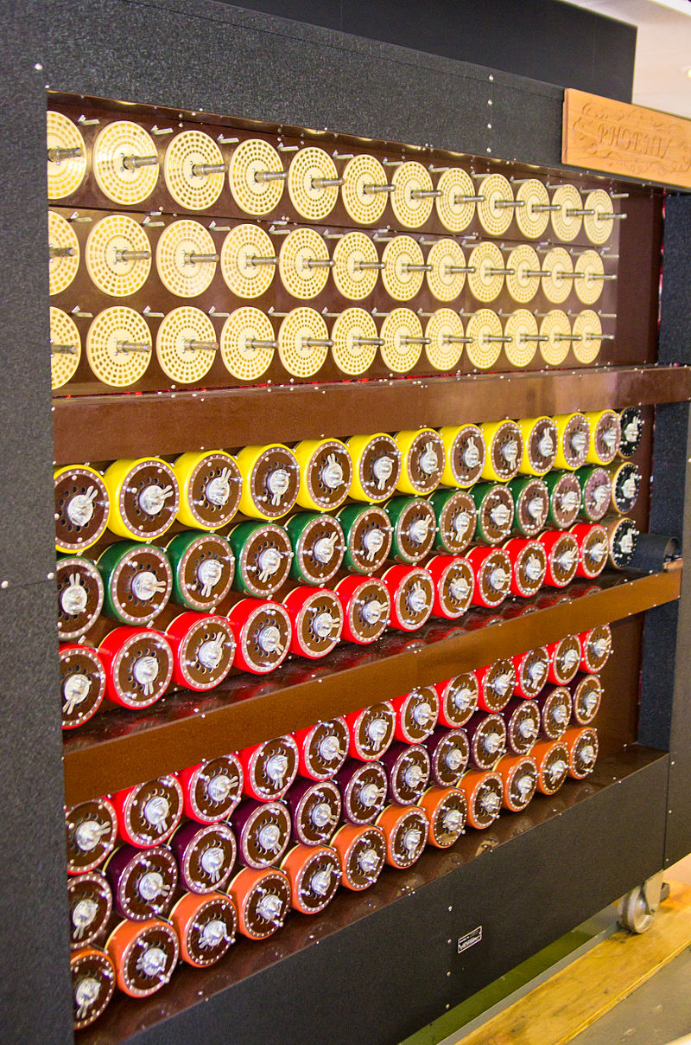
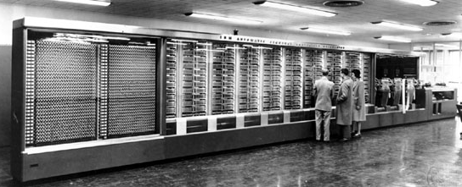
Modern Computers
The ancestors of today’s computers were the electro-mechanical calculators and computers constructed during and just after WWII, such as the “bombe” (left) and Harvard Mark I (below).

Slide 3
Theory of Computing
These computers were based on the research of the first computer theorists. One of these, Alan Turing (1912-1954), had devised a mathematical basis for computing theory and programming (the Turing Machine) and the accompanying concept of Turing Completeness as well as an early assessment of artificial intelligence (the Turing Test).

Slide 4


The Imitation Game (2014)
A dramatization of the work of Turing and codebreaker Joan Clarke, this movie gives a somewhat accurate depiction of the Polish “bombe” code-cracking machine

Slide 5
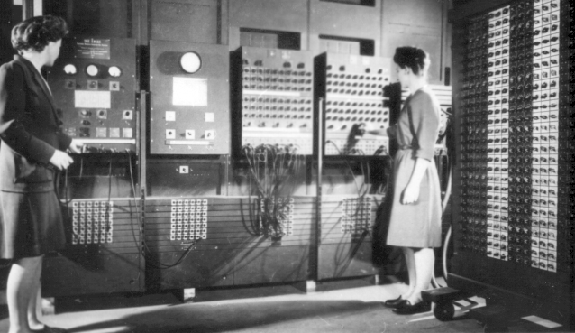
ENIAC (1946)
ENIAC, completed just after the war, was the first electronic, general-purpose, digital, Turing-complete computer that could solve a wide range of problems.

Slide 6
Manchester Mark I (1949)
Constructed at the University of Manchester in England, the Mark I was the first stored-program computer. It also the first computer to use index registers, which allowed the computer to read sequentially through an array of words in memory. Many ideas in this design were incorporated into the first commercial computers such as the IBM 701.

Slide 7
The IBM 701
After WWII Tom Watson Sr, president of IBM, speculated that there was a world market for perhaps five computers. His son, Tom Watson Jr, disagreed and persuaded the company to market a general-purpose computer. This was so successful that the first production run of the IBM 701 was sold out before a single machine was constructed. The 700 series was soon replaced by the 7000 series, which was based on transistors instead of vacuum tubes.

Slide 8
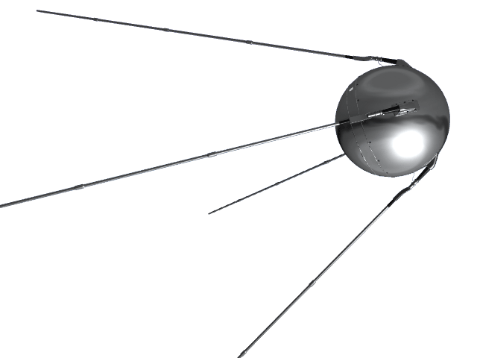
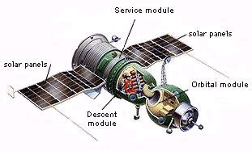
The Space Race
In the early 1960s President Kennedy, in response to early Soviet accomplishments in space, made a commitment that the United States would send a man to the Moon and return him safely before the decade was out.

Slide 9
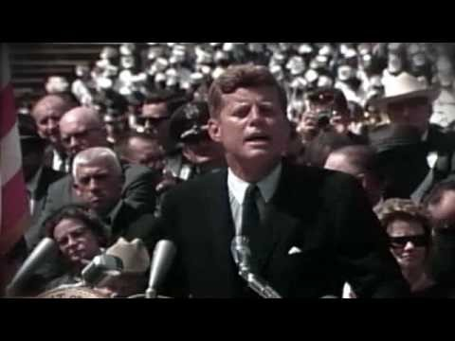

Slide 10
Computers in Space
The requirements of the Space Program included the application of integrated circuits and microprocessors to reduce the size of the computer necessary for installation in the Apollo spacecraft.
The Apollo Guidance Computer had about 2048 words of erasable data memory and about 36 kilowords of read-only rope-core memory. It used 16-bit words and required several thousand first-generation integrated circuits. The user interface was the DSKY display and keyboard.

Slide 11
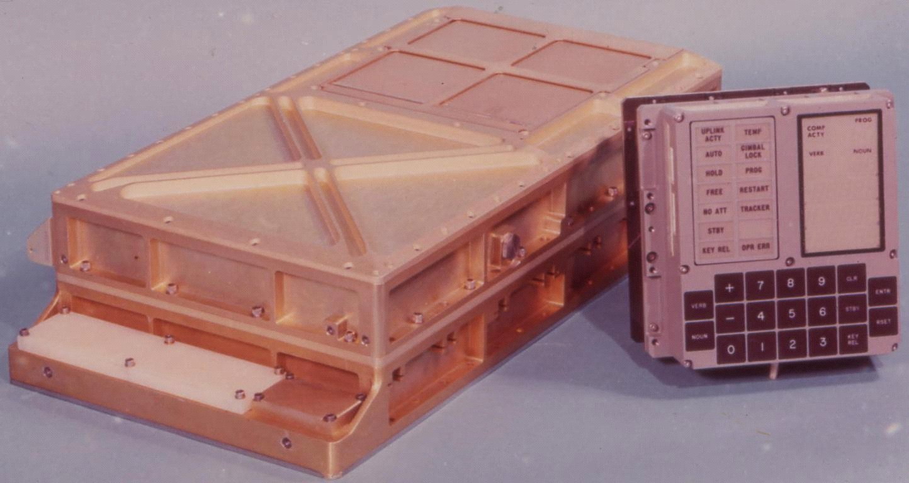
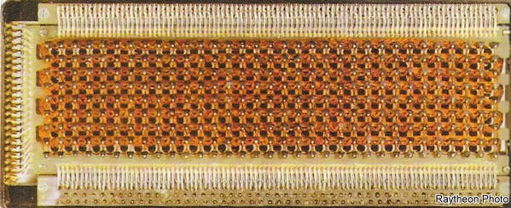
Apollo Guidance Computer and DSKY with hand-made rope-core read-only memory

Slide 12
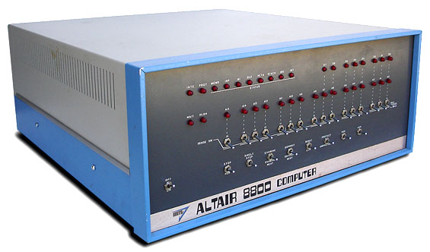
A Computer At Home?
As a result of the advances made during the Apollo program, inexpensive microprocessor-based computers were readily available by the mid to late 1970s. One of the first was the Altair 8800.

Slide 13
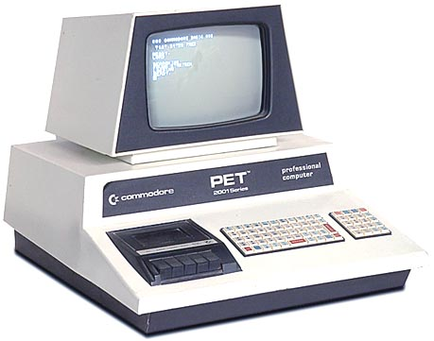
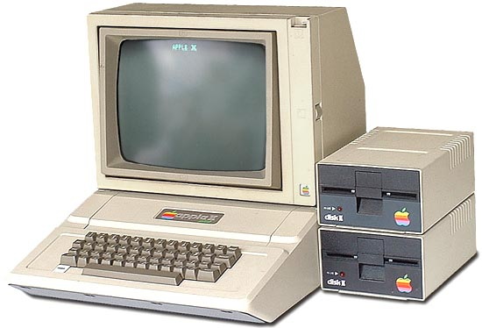
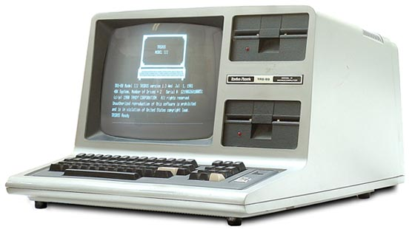
The First Personal Computers
These were quickly followed by the first generation of personal computers. The Commodore PET, Apple ][, and Radio Shack TRS-80 were all immensely popular.

Slide 14
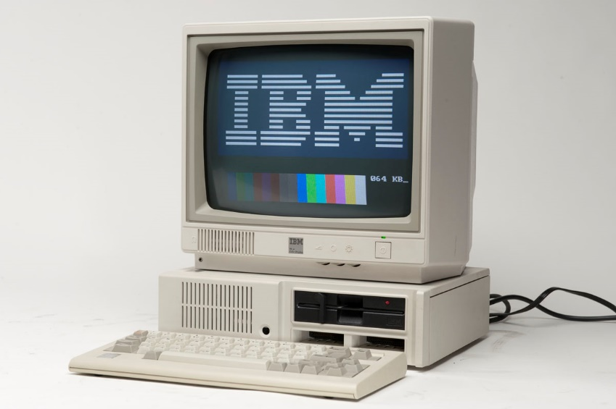
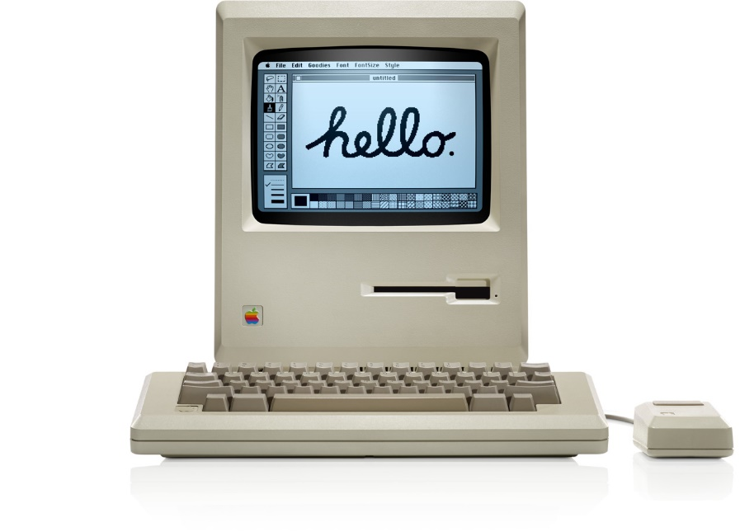
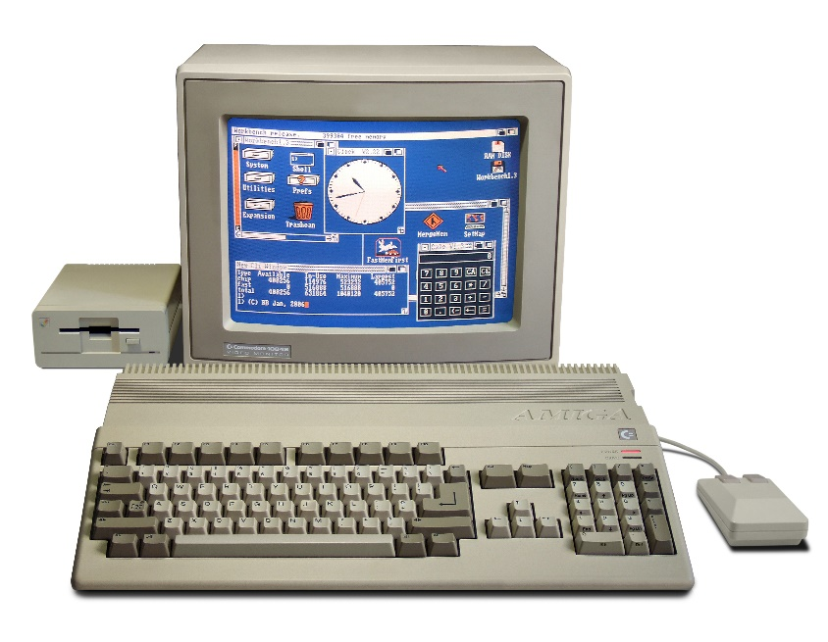
PC Evolution
The next generation included the IBM PC, Apple Macintosh, and Commodore Amiga, with increased memory, more powerful microprocessors, GUI interfaces, and (for two of them) color graphics.

Slide 15
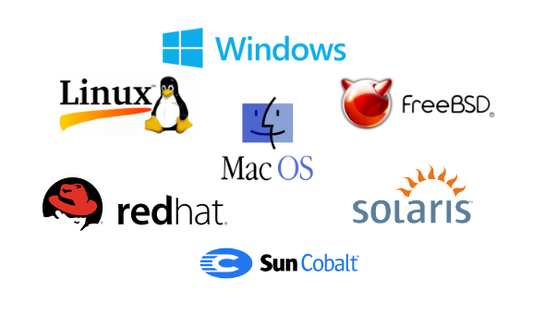
Operating Systems
These computers had (at first) proprietary operating systems. Software written for one of these PC would not run on other platforms.

Slide 16
OS Wars
The large number of proprietary operating systems was soon narrowed down to three: Mac OS (for Apple), Microsoft Windows, and UNIX (as well as UNIX-like languages such as Linux). Mac OS itself eventually was replaced by UNIX at OS X, leaving two principle operating systems in widespread use on computers today.

Slide 17
OS Wars
The large number of proprietary operating systems was soon narrowed down to three: Mac OS (for Apple), Microsoft Windows, and UNIX (as well as UNIX-like languages such as Linux). Mac OS itself eventually was replaced by UNIX at OS X, leaving two principle operating systems in widespread use on computers today.
But what were the origins of these operating systems?
We need to go back in time and find out…

Slide 18
Proprietary Systems
By the mid 1950s there were several competing computing systems, all with proprietary (or at least incompatible) hardware, operating systems, and software. There was an obvious need for general-purpose operating systems and for applications to be written for the operating system, not for the particular computer running that OS.

Slide 19
MULTICS (1964)
One such project was MULTICS (Multiplexed Information and Computing Service), a cooperative project between General Electric, Bell Labs, and MIT.
MULTICS was a general-purpose operating system that pioneered a number of OS features we take for granted today such as dynamic linking, virtual memory, a hierarchical file system, per-process stacks, a command processor, and system security.

Slide 20
MULTICS (1964)
MULTICS failed to deliver these features in a satisfactory manner, mainly because it demanded far more than contemporary computing hardware could deliver. The cooperative alliance was disbanded but General Electric (and later Honeywell, which purchased GE) continued to develop the system. MULTICS gained some commercial success; the last native MULTIX system was operational until 2000.

Slide 21
XEROX PARC
Other advances in computing were made at the Palo Alto Research Center, which was the innovation arm of the XEROX Corporation. They made pioneering advances in (or invented outright) the mouse, the laser printer, the graphic user interface, and Ethernet. These ideas were quickly incorporated into the next generation of personal computers and operating systems, notably the first Macintosh (which was built around these concepts) and Microsoft Windows.

Slide 22
UNIX (1970)
Researchers from Bell Labs who had been involved with the MULTICS project developed a subset of those features into an operating system they jokingly referred to as UNIX, the Uniplexed Information and Computing Service. It is strongly rumored that one motivation for writing this general-purpose operating systems was so that a popular game, Spacewars, could be ported to a newer, faster computer.

Slide 23
UNIX (1970)
UNIX was a successful general-purpose operating system and the authors were encouraged to increase its functionality and feature set with a second version. Reluctant to continue writing in assembly language, they sought an appropriate programming language that was suitable for writing operating systems.

Slide 24
CPL, BCPL, B, B+, and C
They settled upon BCPL (Basic Computer Programming Language), a new but already well-regarded language designed to write compilers. BCPL itself was a subset of CPL, an earlier language that incorporated features that made it difficult to compile. They stripped even more components from BCPL and named the resulting subset B, then added functionality that they knew that would need. They briefly called this new language B+, then chose the name C.

Slide 25
The C Programming Language
C was an immediate success. By deliberate design the language provides a static type system that prevents many unintended side effects and constructs that map efficiently to typical machine instructions, making C code nearly as efficient as assembler. UNIX and C could be used on nearly any computer, and they became the most widely deployed operating system and programming language in the history of computing.

Slide 26
The C Programming Language Evolves
Users of C quickly began to modify the language. One such set of changes drew from object-oriented languages such as Simula 67, Eiffel, and SmallTalk. These early object-oriented versions of C were collectively known as “C with Classes.”

Slide 27
The C Programming Language Evolves
Users of C quickly began to modify the language. One such set of changes drew from object-oriented languages such as Simula 67, Eiffel, and SmallTalk. These early object-oriented versions of C were collectively known as “C with Classes.”
So, what’s an object?

Slide 28
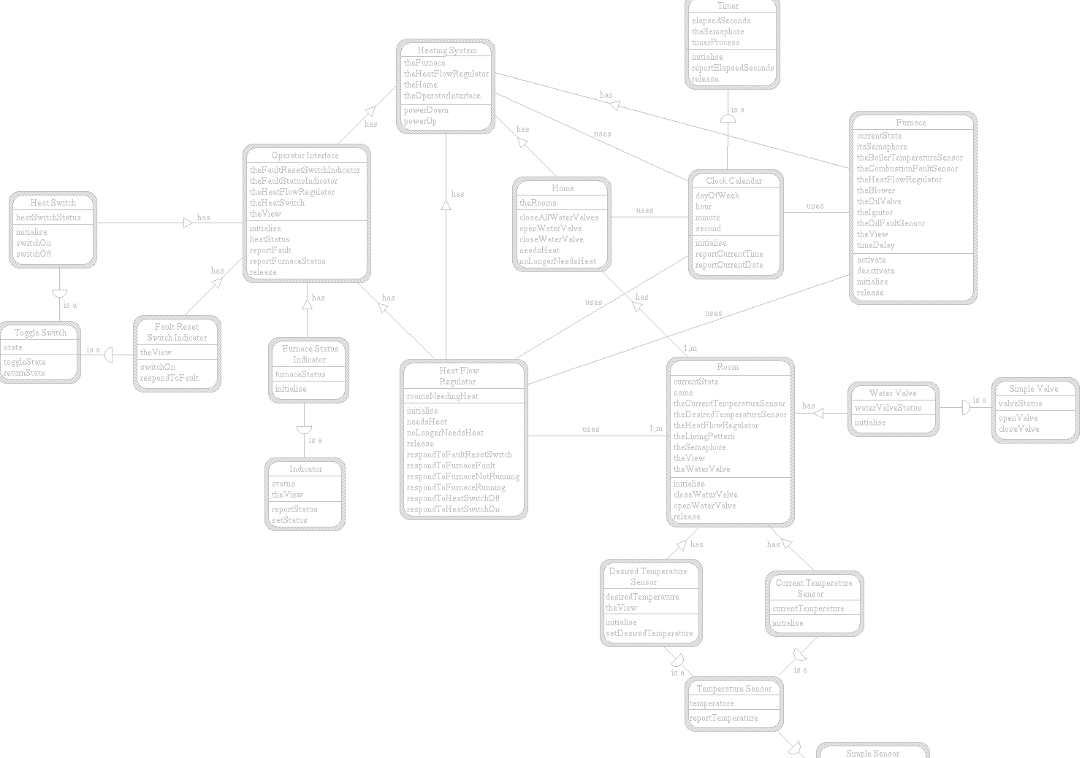
What are Objects?
Objects are program elements that contain both data and code. That is, they can store information and perform operations.

Slide 29
How are objects different?
For example, to sort a primitive array of integers, you send that array to a sorting function. This is known as “procedure-oriented programming.”
An object-oriented array would have a “sort” operation; to sort the array, you simply instruct it to invoke it’s sort behavior. We think of this as “object-oriented programming.”

Slide 30
Primitives and Objects
Primitives
Objects

Slide 31
Primitives and Objects
Primitives
Identity
Objects

Slide 32
Primitives and Objects
Primitives
Identity
State
Objects

Slide 33
Primitives and Objects
Primitives
Identity
State
Objects
Identity
State

Slide 34
Primitives and Objects
Primitives
Identity
State
Objects
Identity
State
Behavior

Slide 35
Classes and Objects
A Class is…

Slide 36
Classes and Objects
A Class is a “blueprint” for an object.

Slide 37
Classes and Objects
A Class is a “blueprint” for an object.
An Object is…

Slide 38
Classes and Objects
A Class is a “blueprint” for an object.
An Object is an instance of a class.

Slide 39
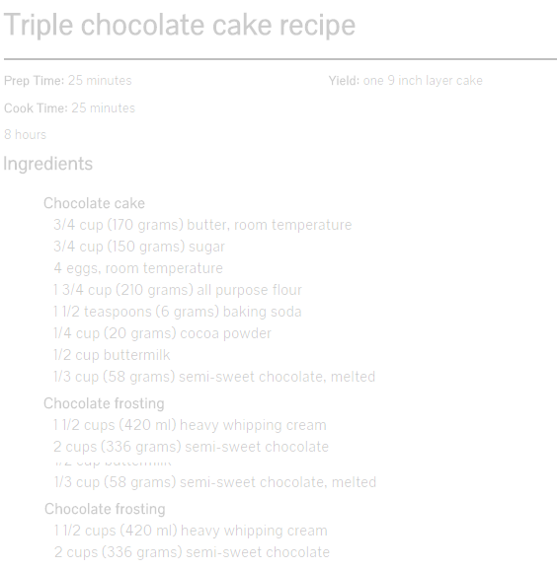
Classes and Objects
The recipe for triple-fudge chocolate cake is a class.

Slide 40

Classes and Objects
The resulting triple-fudge chocolate cake is an object.

Slide 41
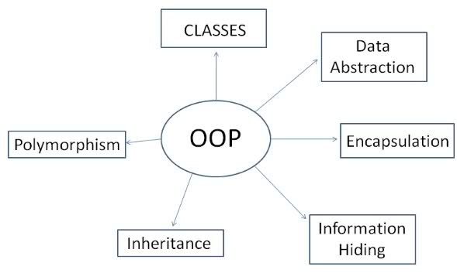
Concepts in Object-Oriented Programming

Slide 42
The C Family
The object-oriented “C with Classes” languages evolved in two new language standards: C++ and Objective C. The lessons learned in the development and use of these two languages resulted in Java and C#. C was the origin or at least had a strong influence on the development of many additional languages. The resulting “C family” of languages include (among many others) C++, Objective C, Java, C#, Lua, PHP, Perl, Python, and Swift.

Slide 43
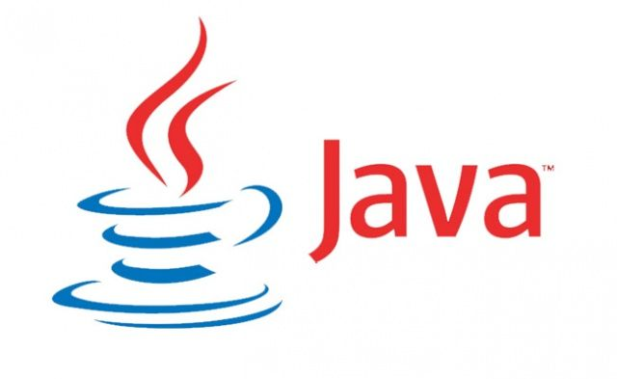
Java originated at Sun Microsystems as a language for “smart” appliances such as interactive television. It quickly evolved into an object-oriented language designed to have as few implementation dependencies as possible. An early goal of Java was “write one, run anywhere.”

Slide 44
Compiled Languages
Most languages include a “compiler” that transforms the abstract natural-language source code into machine instructions. Compiled code is fast, but machine-dependent; a program compiled for one platform would not execute on another.

Slide 45
Interpreted Languages
Some early languages were “interpreted.” BASIC is a famous example. In such languages the interpreter reads the source code and compiles it into machine instructions “on the fly.” Such languages are highly portable at the source-code level, but are usually much slower than compiled languages.

Slide 46
Virtual Machines
To achieve their goal of “write once, run anywhere” Java is “compiled” into “class files” that are written in an intermediate language called bytecode, which is then interpreted by a “virtual machine.” This means that as long as the client computer can run the Java Virtual Machine (JVM), it can run any “compiled” Java program.

Slide 47
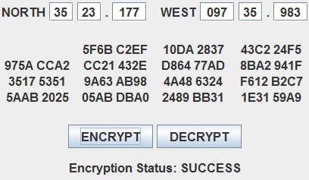
Applets
One immediate application of this concept was to incorporate a subset of the JVM into web browsers, allowing them to run programs imbedded into web pages called “applets.”

Slide 48

Language Wars
Microsoft was quick to license Java and incorporate the JVM into their Internet Explorer web browser. However, Microsoft’s “embrace and extend” philosophy (which resulted in the Microsoft Visual J++ language) did not sit well with Java and there was considerable litigation as to what the licensing agreement allowed.

Slide 49
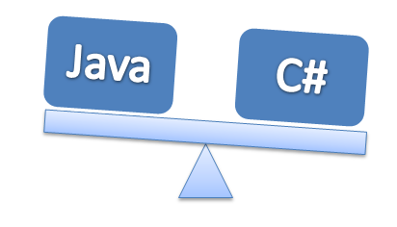
The Empire Strikes Back
Microsoft developed their own object-oriented language that was known in-house as “Java Without The Lawsuits” for some time. This language evolved into C#, which – like Java – compiles into an intermediate language (CLR or Common Language Runtime) that is interpreted by a virtual machine (.NET).

Slide 50
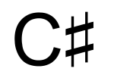
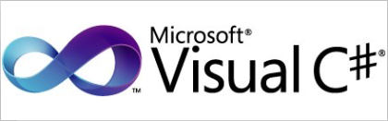

C-Sharp or C-Hash?
For a while Microsoft was adamant that the language be referred to using the musical “sharp” sign, as in .
However, hardly anyone ever does so and even Microsoft isn’t consistent about it.

Slide 51
Android
Programming in Android is done in
C
C++
Objective C
Java

Slide 52
Android
Programming in Android is done in
Java

Slide 53
iProgramming
Programming on Apple devices (the Mac family, the iPhone, the iPad, and such) was (until recently) done in
C
C++
Objective C
Java

Slide 54
iProgramming
Programming on Apple devices (the Mac family, the iPhone, the iPad, and such) was (until recently) done in
Objective C

Slide 55
iProgramming
Objective C++ is being replaced by what new language?

Slide 56
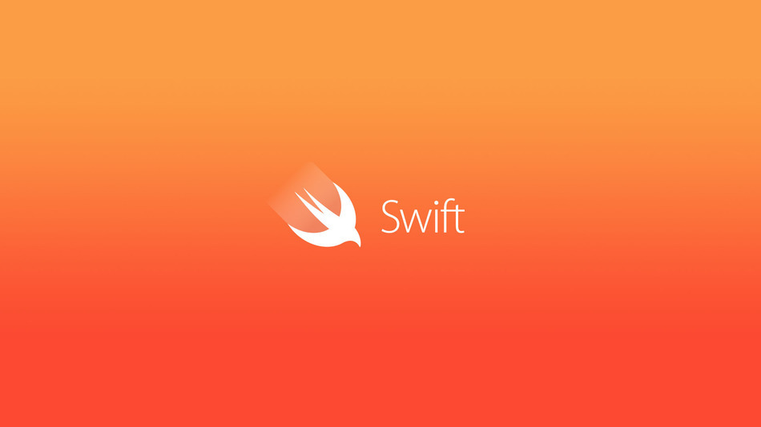
iProgramming
Objective C++ is being replaced by what new language?

Slide 57
Which Is The Most OO Of Them All?
C++ and Objective C are the first of the widely-used OO languages languages.

Slide 58
Which Is The Most OO Of Them All?
C++ and Objective C are the first of the widely-used OO languages languages.
Java is a substantially more OO language than C++.

Slide 59
Which Is The Most OO Of Them All?
C++ and Objective C are the first of the widely-used OO languages languages.
Java is a substantially more OO language than C++.
C# is slightly more OO than Java.

Slide 60
Which Is The Most OO Of Them All?
C++ and Objective C are the first of the widely-used OO languages languages.
Java is a substantially more OO language than C++.
C# is slightly more OO than Java.
Swift is considerably more OO than Objective C.

Slide 61
Which Is Best?
C was designed to write an operating system. Compiled C code maps efficiently to hardware and emphasizes performance over safety. It is a power language for power users; cryptic, powerful, and occasionally dangerous. It is said that while C isn’t the best language for any non-systems application, it’s the second best for everything.

Slide 62
Which Is Best?
C++ adds object-oriented and generic features to C. It also was designed with a bias towards system programming and imbedded, resource-constrained systems, with emphasis on high performance, efficiency, and flexibility. Like C, performance is emphasized over safety. A popular and influential language, features of C++ have made their way into many other languages – including later versions of C itself.

Slide 63
Which Is Best?
Objective C took a different approach to object-oriented programming than did C++, with a heavier emphasis on SmallTalk-style syntax and messaging. Unlike C++, Objective C is a strict superset of C; pure C programs can be compiled in Objective C. Like C, Objective C emphasizes performance over safety and uses data types and instructions that map closely to the hardware.

Slide 64
Which Is Best?
Java is a concurrent, object-oriented, class-based language with emphasis on high portability at the bytecode level. While deriving much of its syntax from C and C++, it differs from those languages in significant ways. In particular, there are fewer low-level facilities (as Java tries to be as independent of the hardware as possible) and safety is emphasized over performance.

Slide 65
Which Is Best?
C# is similar to Java; both compile to an intermediate language that is interpreted by a virtual machine, both are largely independent of the hardware, and both emphasize safety over performance. C# is in many ways a more “pure” OO language than Java. The most significant difference is that, for whatever reason, Microsoft has not incorporated .NET into web browsers, so there is no C# equivalent of a Java applet.

Slide 66
Which Is Best?
Swift, introduced in 2014, is to Objective C what Java is to C++; a language more resilient to erroneous code and with a much greater degree of hardware independence. Swift introduces a new paradigm called “protocol-oriented programming” which emphasizes means by which unrelated objects can communicate with one another.

Slide 67
Which Is Best?
C
C++
Objective C
Java
C#
Swift

Slide 68
Which Is Best?
IT DEPENDS

Slide 69
NEXT LECTURE
Rapid Review with essential similarities and differences between C, C++, and Java.

